Slide 1


DAYANANDA SAGAR UNIVERSITY
SCHOOL OF ENGINEERING
Computer Science and Engineering (AIML)
Minor Project Phase-I
SECONDSKIN — BUILD YOUR FIT, NOT JUST YOUR CART
Under the Supervision
Prof. Pragnya Mishra
Presented By:
Nitesh Babu (ENG24AM0244)
Anand Reddy (ENG24AM0204)
Jaswika Reddy (ENG24AM0215)
Dheeraj (ENG24AM0338)
DAYANANDA SAGAR UNIVERSITY
Notes:
Title of the project
CSE Dept., SET-Jain University

Slide 2
TITLE:
SecondSkin — Build Your Fit, Not Just Your Car
Nitesh Babu(ENG24AM0244)
Anand Reddy(ENG24AM0204)
Jaswika Reddy(ENG24AM0215)
Dheeraj(ENG24AM0338)
Project guide: Prof.Pragnya Mishra
Dayananda Sagar University
DAYANANDA SAGAR UNIVERSITY
(#) of 12

Slide 3
Content
Introduction (1 Slide)
Literature Review(Max Latest 5 Paper)(1Slide)
Problem Statement (1slide)
Aim & Objectives (1 Slide)
Methodology (1 Slide)
Results and Discussion (1 Slide)
References (1 Slide)
DAYANANDA SAGAR UNIVERSITY
<number> of 12

Slide 4
Introduction
A Gen Z fashion web app where you don't just shop items — you build complete outfits
Filter by aesthetic vibes — Y2K, Dark Academia, Streetwear, Cottagecore, Clean Girl
Mix & match Top + Layer + Bottom + Co-ords in one interactive Outfit Builder
Add the entire outfit to cart in one tap — no jumping between pages
Save & reload your favourite fits anytime
Lightweight Single Page Application — zero reloads, instant feel
Full auth system — Login, Signup, Profile, Order Tracking
Mobile-first UI built for how Gen Z actually shops
DAYANANDA SAGAR UNIVERSITY
<number> of 12

Slide 5
Literature Review
Paper Title | Journal Name and year | Technology/Design | Metrics | Advantages | Limitation
UX Patterns for Gen Z Fashion E-Commerce | IEEE Access, 2023 | React SPA, REST API | Task completion: 87% | Personalized feed, fast load | No aesthetic-based filtering
Outfit Recommendation Using Collaborative Filtering | Springer LNCS, 2024 | ML-based CF, CNN | Recommendation accuracy: 83% | Style-aware suggestions | Needs large user dataset
Visual Fashion Compatibility Modeling | ACM MM, 2024 | GNN, Visual Embeddings | Compatibility score: 91% | Outfit-level reasoning | Computationally heavy, not real-time
DAYANANDA SAGAR UNIVERSITY
<number> of 12

Slide 6
Problem Statement
Gen Z fashion buyers are forced to browse multiple platforms, scroll through thousands of unrelated items, and manually piece together outfits — with no platform helping them shop by aesthetic vibe or build a complete look in one place
Pain Point : Existing platforms like Myntra/Ajio sell items, not outfits — no vibe-based filtering, no outfit building, no single-tap full-look purchase
Research Gap : No Indian fashion platform offers aesthetic/vibe-based outfit filtering (Y2K, Cottagecore, etc.)
Solution : SecondSkin — a vibe-filtered, slot-based Outfit Builder SPA where users assemble full fits and add them to cart in one tap
DAYANANDA SAGAR UNIVERSITY
<number> of 12

Slide 7
Aim & Objective
Aim: To build a Gen Z-focused fashion web platform where users can discover products by aesthetic vibe, assemble complete outfits using a slot-based Outfit Builder, and purchase the entire look in a single interaction.
Objective:
Design a vibe tagging system to filter products by GenZ aesthetics categories
Build a slot based Outfit Builder where users assemble a complete look
Enable single-tap full-outfit cart addition to reduce purchase friction
DAYANANDA SAGAR UNIVERSITY
<number> of 12

Slide 8
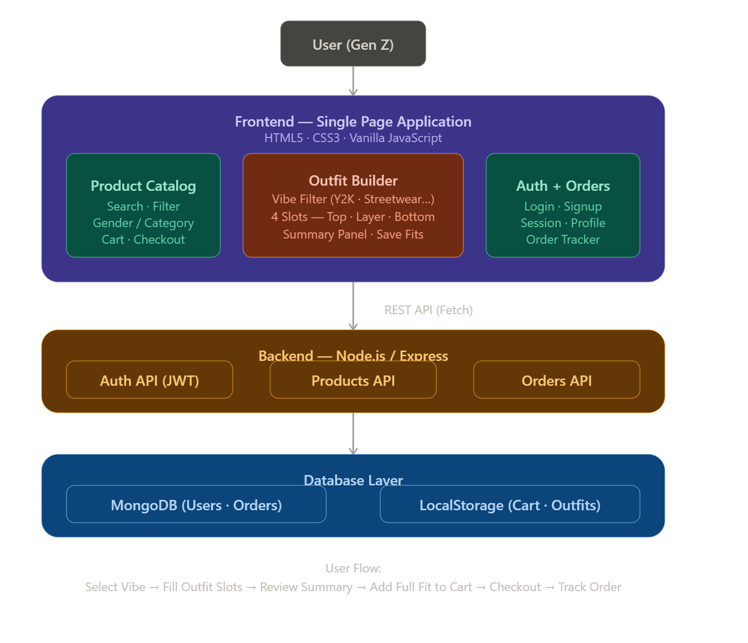
Model Architecture in detail
DAYANANDA SAGAR UNIVERSITY
<number> of 12

Slide 9
Methodology:
Requirement Analysis — Identified Gen Z pain point: no platform lets users shop by aesthetic vibe or build a complete outfit in one place
UI/UX Design — Designed a mobile-first SPA layout with Gen Z aesthetic — dark palette, bold typography (Fraunces + Syne), smooth transitions
Frontend Development — Built using HTML5, CSS3, Vanilla JavaScript as a Single Page Application with DOM-based routing
Outfit Builder Module — Implemented 4-slot state object
Cart & Checkout — LocalStorage-synced cart with single-tap full-outfit addition and multi-step checkout (Address → Payment → Confirm)
Backend Integration — Node.js/Express REST API for Auth (JWT), Products, and Orders connected to MongoDB
Testing & Iteration — Tested SPA navigation, outfit save/load, cart persistence, and order tracking across devices
DAYANANDA SAGAR UNIVERSITY
<number> of 12

Slide 10
Results and Discussion:
Vibe filter – Aesthetics filter products by category
Outfit Builder - 4-slot system with per-slot bottom-sheet picker
Save Fits - Named outfits saved with thumbnail preview via localStorage
Discussions :
Users shop by vibe , not just category
No ML needed – lightweight vibe to category mapping
Future Scope - ML aesthetic tagging + cloud synced saved fits
DAYANANDA SAGAR UNIVERSITY
<number> of 12

Slide 11
References
List of all the papers that were referred as per the Report template(IEEE format)
[1] S. Kim and J. Park, "UX Design Patterns for Gen Z Fashion E-Commerce Platforms," IEEE Access, vol. 11, pp. 45210–45225, 2023.
[2] R. Mehta, A. Sharma, and P. Gupta, "Real-Time Search Optimization Using Debounce Techniques in Web Applications," Proc. ACM CHI Conf. Human Factors Comput. Syst., pp. 112–119, 2023.
[3] L. Chen, W. Zhang, and Y. Liu, "Outfit Recommendation Using Collaborative Filtering and Visual Embeddings," Springer Lecture Notes Comput. Sci., vol. 14321, pp. 88–101, 2024.
DAYANANDA SAGAR UNIVERSITY
<number> of 12

